Slide 1
Metacommunity simulation models
Duarte Viana
Jan 2021

Slide 2
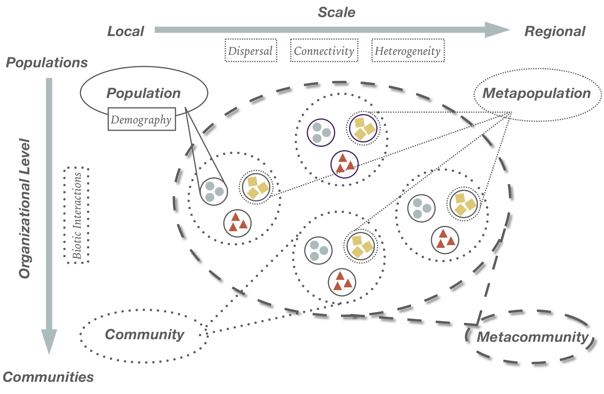
Metacommunity concept

Slide 3
Part A
Basic metapopulation model

Slide 4
Model basic “ingredients”
Metapopulation
N_{t+1} = N_{t} + B – D + I – E
Births (B)
Deaths (D)
Immigration (I)
Emigration (E)

Slide 5
Part B
Individual-based metacommunity model

Slide 6
Model basic “ingredients”
Metacommunity

Slide 7
Synthesis in community ecology
Niche theory
Neutral theory
Regional pool/
Metacommunity
Local
habitat patch
Local
community
Dispersal
Selection
Drift
Number of species
Vellend 2010
Notes:
I’d like to start by quickly summarising the primary processes underlying community assembly, that is how species in a given region become structured in space. Species have first to disperse from a regional pool of species into an habitat patch. And then, selection and drift further filter species in the local habitat patch. This conforms to a niche theory, as selection is an important driver of community assembly.

Slide 8
Synthesis in community ecology
Niche theory
Neutral theory
Regional pool/
Metacommunity
Local
habitat patch
Local
community
Dispersal
Selection
Drift
Number of species
Vellend 2010
Notes:
If we remove selection from the equation, then community assembly becomes neutral.

Slide 9
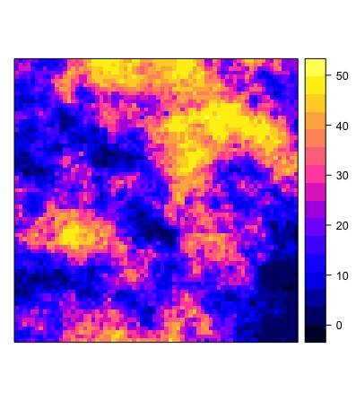
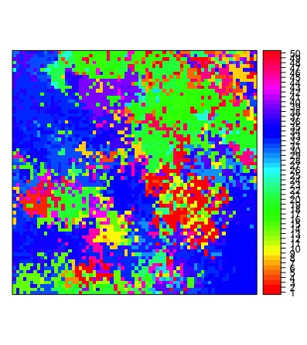
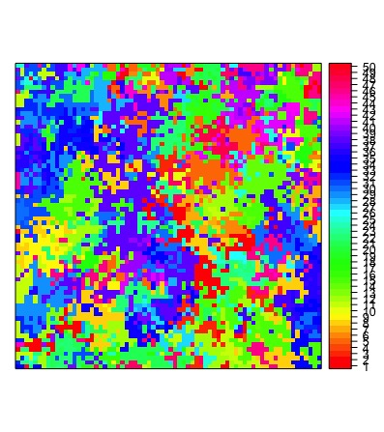
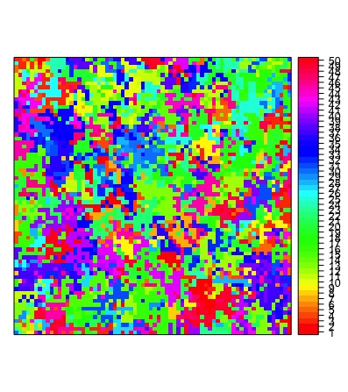
Individual-based model on a grid
Landscape
Niche-based
species distributions
Neutral
species distributions
Intermediate case
+ niche
+ neutral
Notes:
To systematically explore the effect of spatial scale on the inference of assembly processes, we sampled these communities over different spatial extents. Next I’ll show an example with this intermediate case, which might be the most pervasive in nature – an intermediate dispersal capacity and intermediate niche breadth (some niche and some neutrality).

Slide 10
General description of the model (SPATCOM)
individual-based, spatially explicit model
Space is defined as a grid (lattice) where each cell is occupied by only one individual
The global community is assembled on a landscape composed of one or more environmental variables
Basic processes (in each time step):
mortality (neutral or niche-based)
reproduction (propagule production; neutral or niche-based)
dispersal (according to a defined dispersal kernel)
colonisation (neutral or niche-based)
Viana & Chase 2019

Slide 11
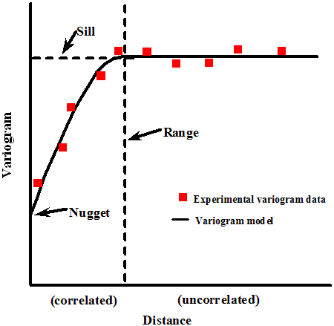
Dissecting the model
Build the grid and respective landscape
Environmental variable(s) can have different spatial structures: random or autocorrelated
Autocorrelated environmental variables are generated with Gaussian random fields
The ”grain” of autocorrelation is defined according to the ”range” parameter of a variogram model
Variogram
Landscape

Slide 12
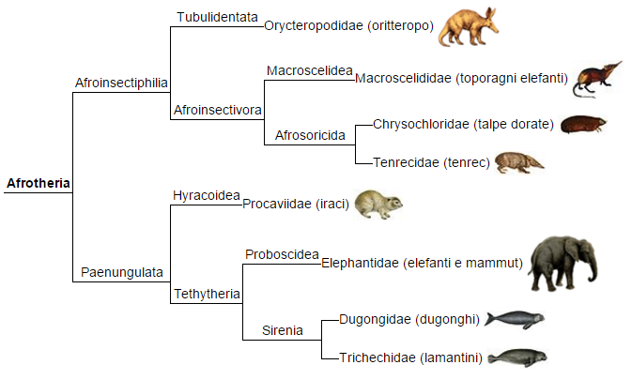
Dissecting the model
2. Define the species pool and distribute them over the grid
Species can be functionally equivalent or have different niches
Niches can be regularly spaced across the environmental gradient or have a phylogenetic structure
The phylogenetic structure might be defined according to a Brownian-motion model of evolutionary trajectories

Slide 13
Dissecting the model
3. Community assembly: mortality and reproduction
Mortality (D) = 0.02
Reproduction (synchronous)
Reproductive population (M) = 0.7
Nr. Propagules (Z) = 10 (per mother)

Slide 14
Dissecting the model
3. Community assembly : dispersal
Dispersal (lognormal kernel)
Location = 0 (log-median distance)
Scale = 0.1 – 7 (tail thickness)

Slide 15
Dissecting the model
3. Community assembly : niche
Niche (Gaussian distribution)
Niche optimum = trait value
Niche breadth = amount of overlap between the species’niches
A species performance (λ) in a given environment (E) is given by
λ_{i} (E) = exp(-(E - µ_{i})² / 2σ²)
Niche dependent processes (mortality, reproduction, colonisation); unless neutral

Slide 16
Dissecting the model
4. Run simulation
Define number of generations (G; model iterations)
In each time step, simulate mortality, reproduction, dispersal and colonisation

Slide 17
Part C
Population-based metacommunity model

Slide 18
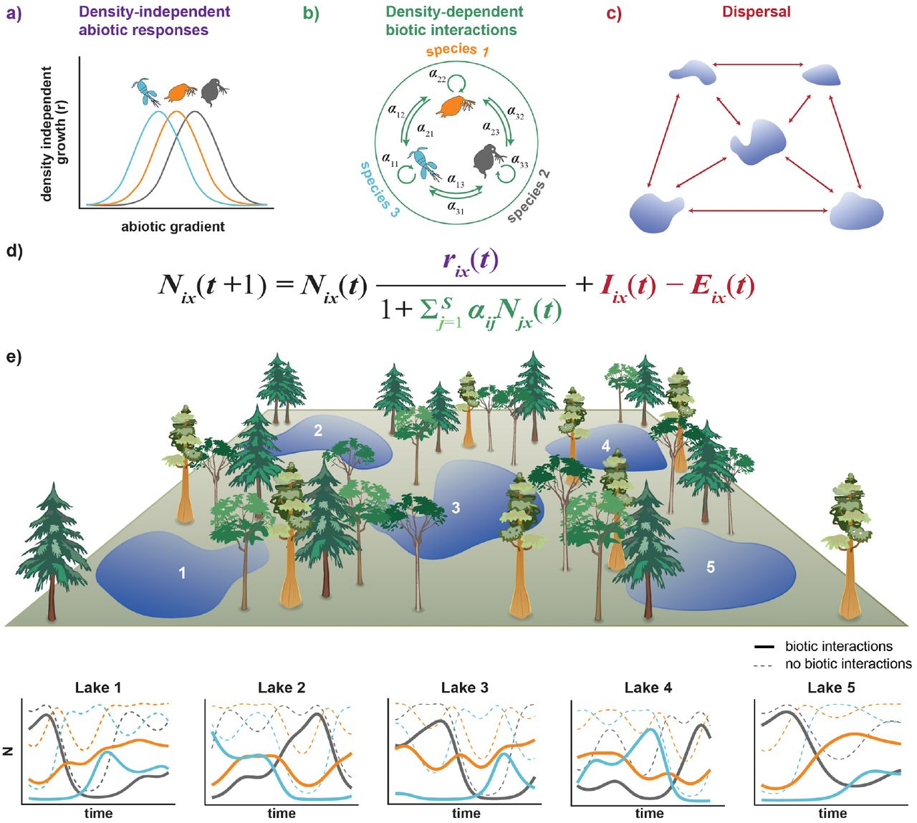
Metacommunity dynamics
Modern framework
Thompson et al. 2020

Slide 19
Density-dependent species interactions
α_{i,j} is a phenomenological parameter in Lotka-Volterra models: the per capita impact of species j on species i
equal competition: α_{j,i} = α_{i,i} = α_{i,j} = α_{j,j} individuals of all species compete equally, so that coexistence is unstable but exclusion is slow and determined by stochastic processes
stabilizing competition: α_{j,i} < α_{i,i} and α_{i,j} < α_{jj} species compete more strongly with themselves than with each other
competitive dominance: α_{j,i} > α_{i,i} and α_{i,j} < α_{j,j} competition is unbalanced so that the superior competitor i excludes the inferior species j, regardless of initial abundances
destabilizing competition: α_{j,i} > α_{i,i} and α_{i,j} > α_{j,j} species compete with each other more strongly than with themselves so that the species with higher initial abundance excludes the other species
α_{i,i}
Sp i
α_{i,j}
α_{j,i}
Sp j
α_{j,j}

Slide 20
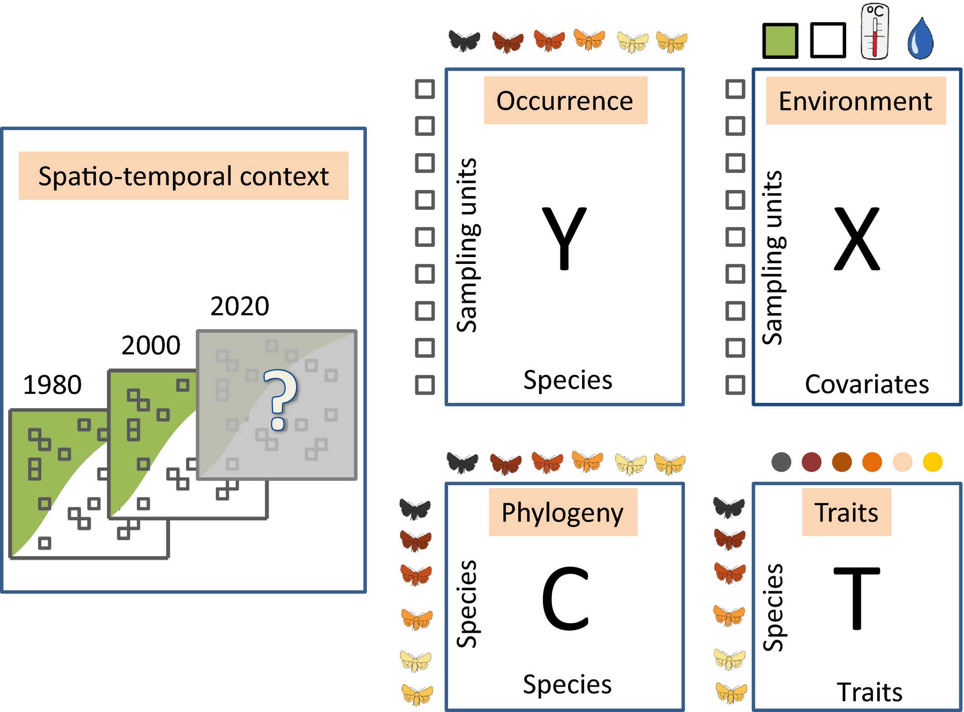
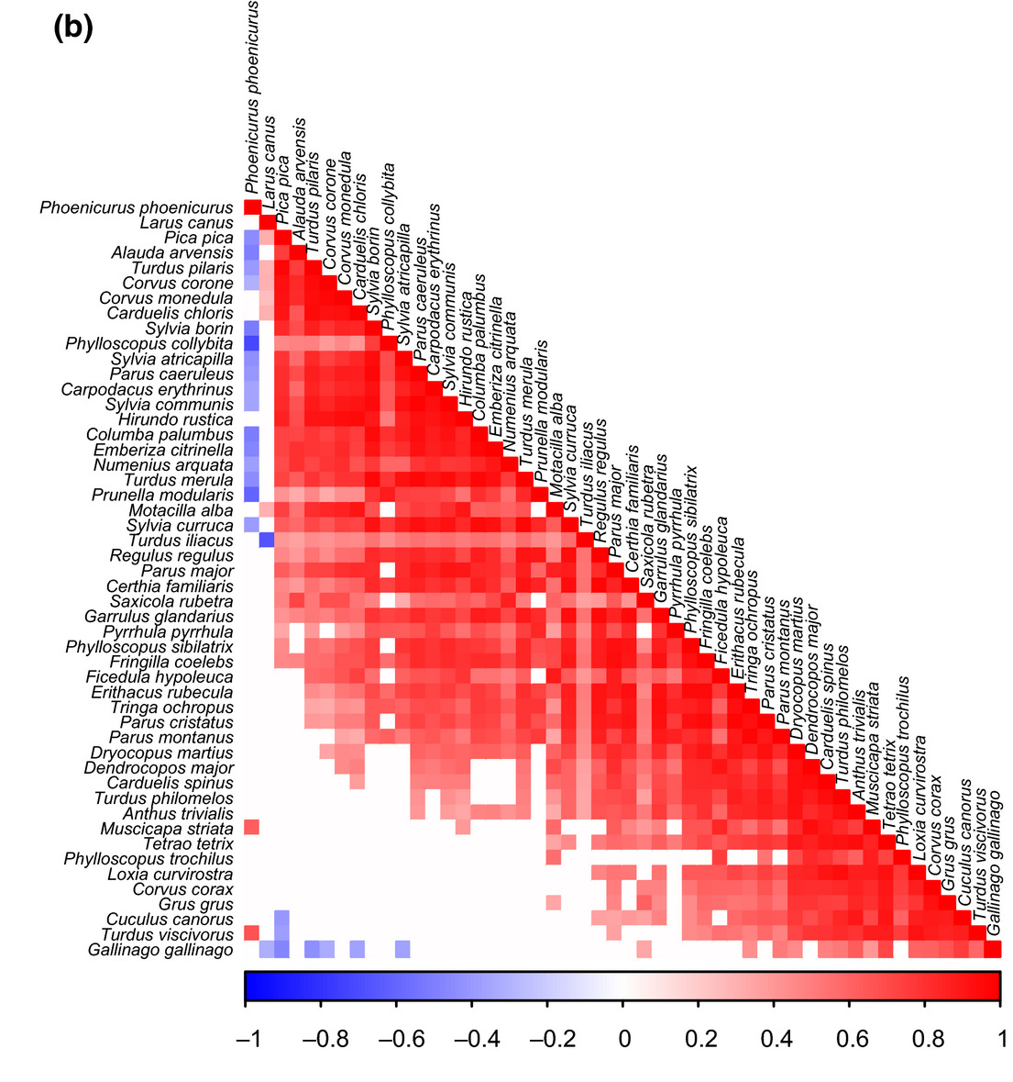
Joint Species Distribution Models (JSDM)
Inference of species co-occurrence

